Slide 1
ARTIFICIAL INTELLIGENCE
3
Handayani Tjandrasa

Slide 2
Search Algorithms
Blind search – BFS, DFS, uniform cost
no notion concept of the “right direction”
can only recognize goal once it’s achieved
Heuristic search – we have rough idea of how good various states are, and use this knowledge to guide our search

Slide 3
Blind Strategies
Breadth-first
Bidirectional
Depth-first
Depth-limited
Iterative deepening
Uniform-Cost
Step cost = 1
Step cost = c(action)
≥ ε > 0

Slide 4
Breadth-First Strategy
New nodes are inserted at the end of FRINGE
1
2
3
FRINGE = (1)
4
5
6
7

Slide 5
Breadth-First Strategy
New nodes are inserted at the end of FRINGE
1
2
3
FRINGE = (2, 3)
4
5
6
7

Slide 6
Breadth-First Strategy
New nodes are inserted at the end of FRINGE
1
2
3
FRINGE = (3, 4, 5)
4
5
6
7

Slide 7
Breadth-First Strategy
New nodes are inserted at the end of FRINGE
1
2
3
FRINGE = (4, 5, 6, 7)
4
5
6
7

Slide 8
Evaluation
b: branching factor
d: depth of shallowest goal node
Complete
Optimal if step cost is 1
Number of nodes generated: 1 + b + b² + … + b^{d} + b(b^{d}-1) = O(b^{d+1})
Time and space complexity is O(b^{d+1})

Slide 9
Depth-First Strategy
New nodes are inserted at the front of FRINGE
1
2
3
FRINGE = (1)
4
5

Slide 10
Depth-First Strategy
New nodes are inserted at the front of FRINGE
1
2
3
FRINGE = (2, 3)
4
5

Slide 11
Depth-First Strategy
New nodes are inserted at the front of FRINGE
1
2
3
FRINGE = (4, 5, 3)
4
5

Slide 12
Depth-First Strategy
New nodes are inserted at the front of FRINGE
1
2
3
4
5

Slide 13
Depth-First Strategy
New nodes are inserted at the front of FRINGE
1
2
3
4
5

Slide 14
Depth-First Strategy
New nodes are inserted at the front of FRINGE
1
2
3
4
5

Slide 15
Depth-First Strategy
New nodes are inserted at the front of FRINGE
1
2
3
4
5

Slide 16
Depth-First Strategy
New nodes are inserted at the front of FRINGE
1
2
3
4
5

Slide 17
Depth-First Strategy
New nodes are inserted at the front of FRINGE
1
2
3
4
5

Slide 18
Depth-First Strategy
New nodes are inserted at the front of FRINGE
1
2
3
4
5

Slide 19
Depth-First Strategy
New nodes are inserted at the front of FRINGE
1
2
3
4
5

Slide 20
Evaluation
b: branching factor
d: depth of shallowest goal node
m: maximal depth of a leaf node
Complete only for finite search tree
Not optimal
Number of nodes generated: 1 + b + b² + … + b^{m} = O(b^{m})
Time complexity is O(b^{m}) (worst case)
Space complexity is O(bm)

Slide 21
Uniform-Cost Strategy
Each step has some cost ≥ ε > 0.
The cost of the path to each fringe node N is
g(N) = Σ costs of all steps.
The goal is to generate a solution path of minimal cost.
The queue FRINGE is sorted in increasing cost.
S
A
0
1
10
S
5
B
5
G
A
B
C
1
5
15
5
15
C
G
G
11
10

Slide 22
Informed (Heuristic) Search

Slide 23
Search with Domain Knowledge added
Uninformed (blind) searches are normally very inefficient
Adding domain knowledge can improve the search process.

Slide 24
Concept of informed (heuristic) search
Heuristic (informed) search -> explore the node that is most “likely” to be the nearest to a goal state.
There is no guarantee that the heuristic provided most “likely” node will get you closer to a goal state than any other.

Slide 25
Knowledge/info
Example:
Visit the doctor
Symptoms: fever, nausea, headache, …
Leading questions: how long?, traveled?, … (Malaria, typhoid, meningitis, flu,..)
x Blood test, y test,...

Slide 26
Knowledge/info
Example:
Climbing a hill in thick Fog
Heuristic function: check the change in altitude in 4 directions; the strongest increase is the direction in which to move next.

Slide 27
Heuristic Search Methods
Methods that use a heuristic function to provide specific knowledge about the problem:
Heuristic Functions
Hill climbing
Greedy search
A* search algorithm

Slide 28
Informed Search
Add domain-specific information to select the best path along which to continue searching
Define a heuristic function, h(n), that estimates the “goodness” of a node n.
Specifically, h(n) = estimated cost (or distance) of minimal cost path from n to a goal state.
The heuristic function is an estimate, based on domain-specific information that is computable from the current state description, of how close we are to a goal

Slide 29
Hill-climbing search
If there exists a successor s for the current state n such that
h(s) < h(n)
h(s) <= h(t) for all the successors t of n,
then move from n to s. Otherwise, halt at n.
Looks one step ahead to determine if any successor is better than the current state; if there is, move to the best successor.
Similar to Greedy search in that it uses h, but does not allow backtracking or jumping to an alternative path since it doesn’t “remember” where it has been.
Not complete since the search will terminate at "local minima," "plateaus," and "ridges."

Slide 30
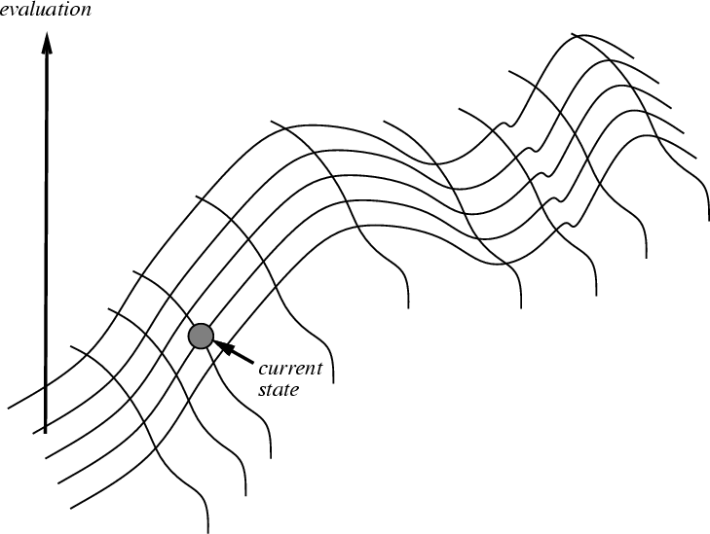
Hill climbing on a surface of states
Height Defined by Evaluation Function

Slide 31
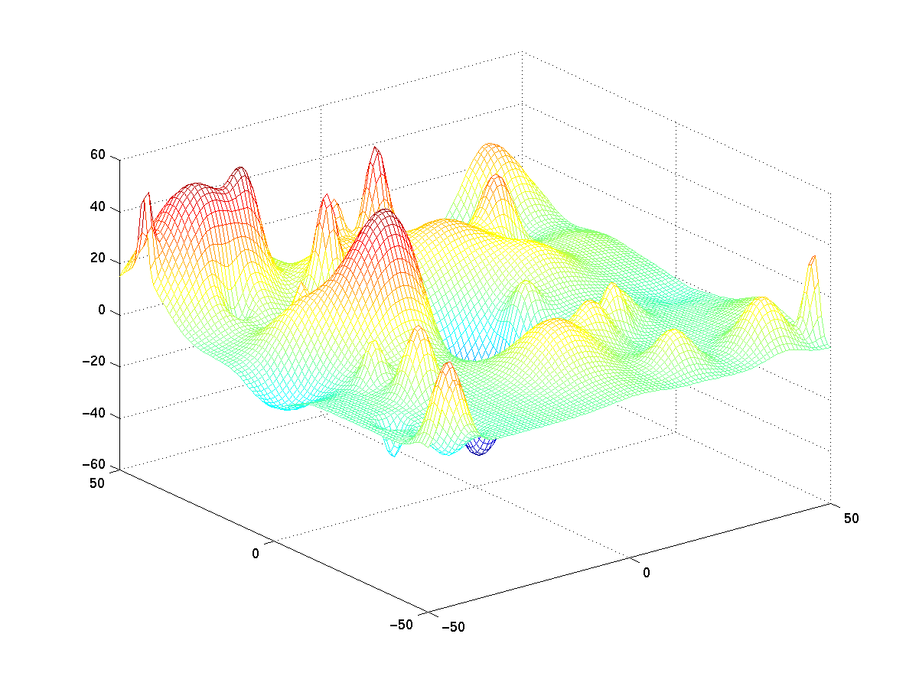
Hill climbing
Steepest descent (~ greedy best-first with no search) → may get stuck into local minimum

Slide 32
Robot Navigation
Local-minimum problem
f(N) = h(N) = straight distance to the goal

Slide 33
Drawbacks of hill climbing
Problems:
Local Maxima: peaks that aren’t the highest point in the space
Plateaus: the space has a broad flat region that gives the search algorithm no direction (random walk)
Ridges: flat like a plateau, but with dropoffs to the sides; steps to the North, East, South and West may go down, but a step to the NW may go up.
Remedy:
Introduce randomness
Random restart.
Some problem spaces are great for hill climbing and others are terrible.

Slide 34
Hill climbing example
2
8
3
1
2
3
start
1
6
4
h = -4
goal
8
4
h = 0
7
5
7
6
5
-5
-5
-2
2
8
3
1
2
3
1
4
h = -3
8
4
h = -1
7
6
5
7
6
5
-4
-3
2
3
2
3
h = -3
1
8
4
1
8
4
h = -2
7
6
5
7
6
5
-4
f(n) = -(number of tiles out of place)

Slide 35
Example of a local maximum
1
2
5
-4
7
4
start
8
6
3
goal
1
2
5
1
2
5
1
2
5
7
4
7
4
-4
7
4
0
8
6
3
8
6
3
8
6
3
-3
1
2
5
7
4
-4
8
6
3

Slide 36
Greedy Search
f(N) = h(N) → greedy best-first

Slide 37
Robot Navigation

Slide 38
Robot Navigation
f(N) = h(N), with h(N) = Manhattan distance to the goal
8
7
6
5
4
3
2
3
4
5
6
7
5
4
3
5
6
3
2
1
0
1
2
4
7
6
5
8
7
6
5
4
3
2
3
4
5
6

Slide 39
Robot Navigation
f(N) = h(N), with h(N) = Manhattan distance to the goal
8
7
6
5
4
3
2
3
4
5
6
7
5
4
3
5
6
3
2
1
0
0
1
2
4
7
What happened???
7
6
5
8
7
6
5
4
3
2
3
4
5
6

Slide 40
Heuristic Searches - Greedy search
So named as it takes the biggest “bite” it can out of the problem. That is, it seeks to minimise the estimated cost to the goal by expanding the node estimated to be closest to the goal state
in other words,
Always expand the heuristically best nodes first.

Slide 41
Greedy search algorithm
1. QUEUE <-- path only containing the root;
2. WHILE
QUEUE is not empty
AND goal is not reached
DO
remove the first path from the QUEUE;
create new paths (to all children);
reject the new paths with loops;
add the new paths and sort the entire QUEUE;
3. IF goal reached
THEN success;
ELSE failure;

Slide 42
Heuristic Searches - Greedy Search
It is only concerned with short term aims
It is possible to get stuck in an infinite loop, unless you check for repeated states
It is not optimal
It is not complete
Time and space complexity is O(B^{m}); where m is the depth of the search tree

Slide 43
More informed search
We kept looking at nodes closer and closer to the goal, but were accumulating costs as we got further from the initial state
Our goal is not to minimize the distance from the current head of our path to the goal, we want to minimize the overall length of the path to the goal!
Let g(N) be the cost of the best path found so far between the initial node and N
f(N) = g(N) + h(N)

Slide 44
Robot Navigation
f(N) = g(N)+h(N), with h(N) = Manhattan distance to goal
8+3
8+3
7+4
7+4
6+5
6+3
5+6
5+6
4+7
4+7
3+8
3+8
2+9
8
7
6
5
4
3
2+9
3+10
2
3
4
5
6
7+2
7+2
5+6
4+7
3+8
7
5
4
3+8
3
5
6+1
6+1
2+9
2+9
1+10
6
3
2
1+10
0+11
1
0
1
2
4
7+0
7+0
6+1
7
6+1
6
5
8+1
8+1
7+2
7+2
6+3
6+3
5+4
5+4
4+5
4+5
3+6
3+6
2+7
8
7
6
5
4
3
2+7
3+8
2
3
4
5
6

Slide 45
Can we Prove Anything?
If the state space is finite and we avoid repeated states, the search is complete, but in general is not optimal
If the state space is finite and we do not avoid repeated states, the search is in general not complete
If the state space is infinite, the search is in general not complete

Slide 46
Admissible heuristic
Let h*(N) be the true cost of the optimal path from N to a goal node
Heuristic h(N) is admissible if: 0 ≤ h(N) ≤ h*(N)
An admissible heuristic is always optimistic

Slide 47
A* Search
Evaluation function: f(N) = g(N) + h(N) where:
g(N) is the cost of the best path found so far to N
h(N) is an admissible heuristic
Then, best-first search with this evaluation function is called A* search
Important AI algorithm developed by Fikes and Nilsson in early 70s. Originally used in Shakey robot.

Slide 48
Completeness & Optimality of A*
Claim 1: If there is a path from the initial to a goal node, A* (with no removal of repeated states) terminates by finding the best path, hence is:
complete
optimal
requirements:
0 < ε ≤ c(N,N’)
Each node has a finite number of successors

Slide 49
Example of Evaluation Function
f(N) = (sum of distances of each tile to its goal)
+ 3 x (sum of score functions for each tile)
where score function for a non-central tile is 2 if it is
not followed by the correct tile in clockwise order
and 0 otherwise
5
8
1
2
3
f(N) = 2 + 3 + 0 + 1 + 3 + 0 + 3 + 1
3x(2 + 2 + 2 + 2 + 2 + 0 + 2)
= 49
4
2
1
4
5
6
7
3
6
7
8
N
goal

Slide 50
Heuristic Function
Function h(N) that estimates the cost of the cheapest path from node N to goal node.
Example: 8-puzzle
5
8
1
2
3
h(N) = number of misplaced tiles = 6
4
2
1
4
5
6
7
3
6
7
8
N
goal

Slide 51
Heuristic Function
Function h(N) that estimate the cost of the cheapest path from node N to goal node.
Example: 8-puzzle
5
8
1
2
3
h(N) = sum of the distances of
every tile to its goal position
= 2 + 3 + 0 + 1 + 3 + 0 + 3 + 1
= 13
4
2
1
4
5
6
7
3
6
7
8
N
goal

Slide 52
8-Puzzle
f(N) = h(N) = number of misplaced tiles
3
3
4
5
3
4
2
4
2
1
3
3
0
4
5
4

Slide 53
8-Puzzle
f(N) = g(N) + h(N)
with h(N) = number of misplaced tiles
3+3
1+5
2+3
3+4
5+2
0+4
3+2
4+1
1+3
2+3
5+0
3+4
1+5
2+4

Slide 54
8-Puzzle
f(N) = h(N) = Σ distances of tiles to goal
6
5
2
5
2
1
4
3
0
4
6
5

Slide 55
8-Puzzle
5
8
1
2
3
4
2
1
4
5
6
7
3
6
7
8
N
goal
h1(N) = number of misplaced tiles = 6 is admissible
h2(N) = sum of distances of each tile to goal = 13 is admissible
h3(N) = (sum of distances of each tile to goal) + 3 x (sum of score functions for each tile) = 49 is not admissible

Slide 56
8-Puzzle
f(N) = g(N) + h(N)
with h(N) = number of misplaced tiles
3+3
1+5
2+3
3+4
5+2
0+4
3+2
4+1
1+3
2+3
5+0
3+4
1+5
2+4

Slide 57
Robot navigation
f(N) = g(N) + h(N), with h(N) = straight-line distance from N to goal
Cost of one horizontal/vertical step = 1
Cost of one diagonal step = √2

Slide 58
Example: road map
G
3
Imagine the problem of finding a route on a road map and that the NET below is the road map:
C
F
4
4
B
5
E
4
2
Define f(T) = the straight-line distance from T to G
5
D
A
A
10.4
B
6.7
C
4
3
4
11
The estimate
can be wrong!
S
S
8.9
G
D
E
6.9
F
3

Slide 59
Road map example: Re-introduce the costs of paths in the NET
4
4
3
A
B
C
S
5
5
G
4
3
D
2
E
4
F
3
S
4
4
A
D
2
5
5
B
D
A
E
4
5
2
4
5
4
C
2
E
4
5
E
B
B
F
4
4
5
4
4
3
D
F
B
F
C
E
A
C
G
3
4
3
4
G
C
G
F
3
G

Slide 60
A look at Uniform cost search
3
S
4
3
4
4
A
5
D
At each step, select the node with the lowest accumulated cost.
5
2
B
7
8
A
9
6
D
5
E
4
5
5
4
4
C
11
12
13
B
13
B
11
F
10
E
E
3
D
F
B
F
C
E
A
C
G
13
G
C
G
F
G

Slide 61
A* Algorithm Example: road map
G
3
Imagine the problem of finding a route on a road map. The paths distances between nodes define g(n):
C
F
4
4
B
5
E
4
2
Define h(n) = the straight-line distance from node to G
5
D
A
A
10.4
B
6.7
C
4
3
4
11
S
S
8.9
G
D
E
6.9
F
3

Slide 62
S
3 + 10.4 = 13.4
A
D
4 + 8.9 = 12.9
S
A
13.4
D
9 + 10.4 = 19.4
A
E
6 + 6.9 = 12.9
X
S
A
13.4
D
A
E
X
11 + 6.7 = 17.7
B
F
10 + 3.0 = 13.0
S
A
13.4
D
A
E
STOP!
X
17.7
B
F
G
13 + 0.0 = 13.0

Slide 63
Reference
Russel, Stuart J., Peter Norvig, "Artificial Intelligence, a modern approach“, Second Edition, Prentice Hall, New Jersey, 2003.
Winston, Patrick Henry, "Artificial Intelligence“, Addison –Wesley.

Slide 64
TERIMA KASIH

